Slide 1

BANKRUPTCY PREVENCTION
Under Guidance of: Mr.Dilavar Bhasa
Project By:
Jeshma Hasti
Ramireedy Vara Lakshmi Devika
Avulapati Swetha
Vaishnavi Abhimanyu Sonune
Kante Sampath Kumar
Shreyank H
A Dhananjaya Kumar

Slide 2
Contents
BUSINESS OBJECTIVE
APPROACH
SELECTING BEST MODEL
MODEL DEPLOYMENT
RESULTS
CHALLENGES

Slide 3
BUSINESS OBJECTIVE
This is a classification project, since the variable to predict is binary (bankruptcy or non-bankruptcy).
The goal here is to model the probability that a business goes bankrupt from different features
Approach
Import the data set
Exploratory Data Analysis
Data Cleaning
Correlation &Visualizations
Transformations
Model Fitting
Cross Validation
Metrics
Selecting Best Model
Model Deployment

Slide 4
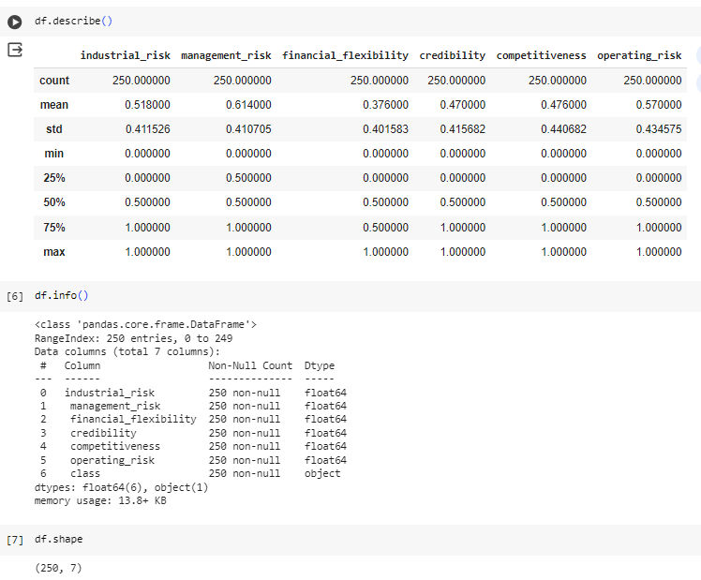
Exploratory Data Analysis(EDA)
Describe():
The describe() method returns description of the data in the dataset.
Info():
The info() method prints information about the dataset.
Shape:
fetch the dimensions of the dataset.

Slide 5
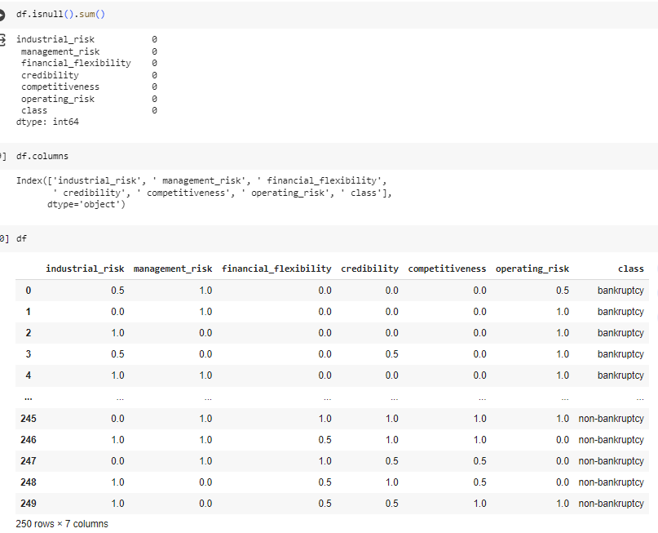
EDA(Contd)
Isnull().sum():
Calling the sum() method on the isnull() series returns the count of True values which actually corresponds to the number of NaN values.
Columns:
To get the column names in the dataset

Slide 6
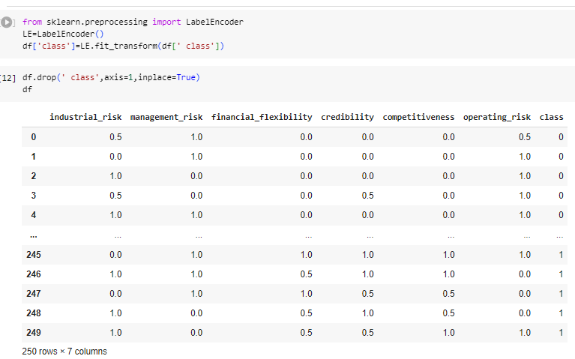
EDA(Contd)
Label Encoder:
Encode target labels with value between 0 and n_classes-1.
This transformer should be used to encode target values

Slide 7
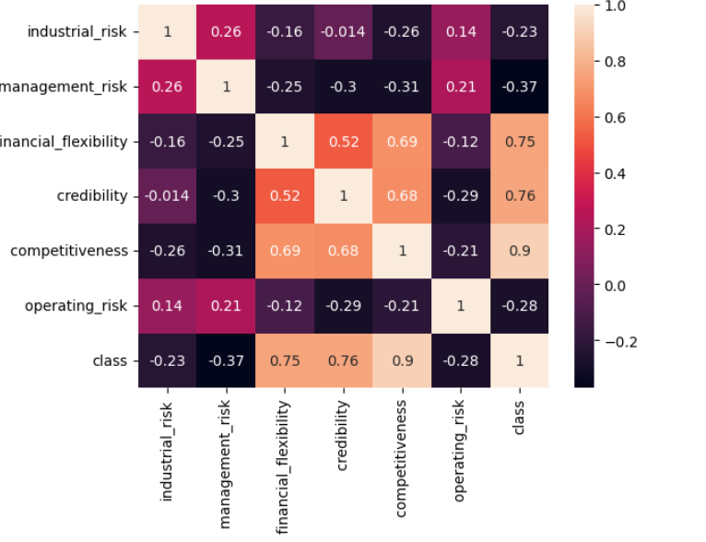
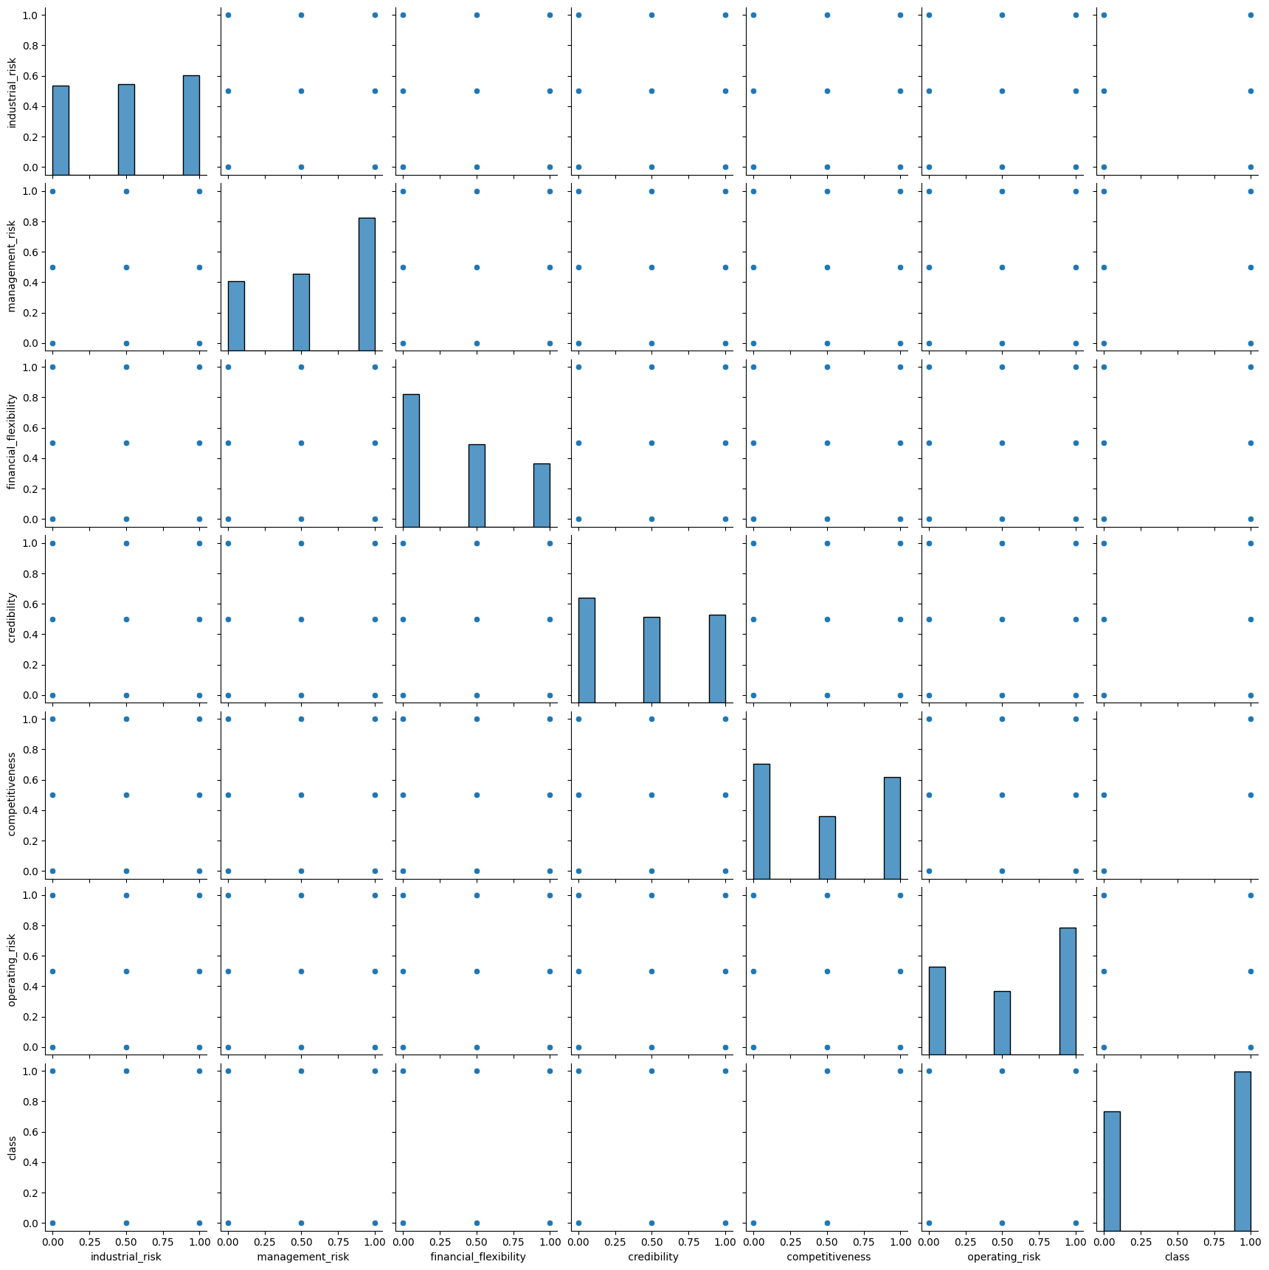
Correlation & Visualization
Correlation
Pair plot

Slide 8
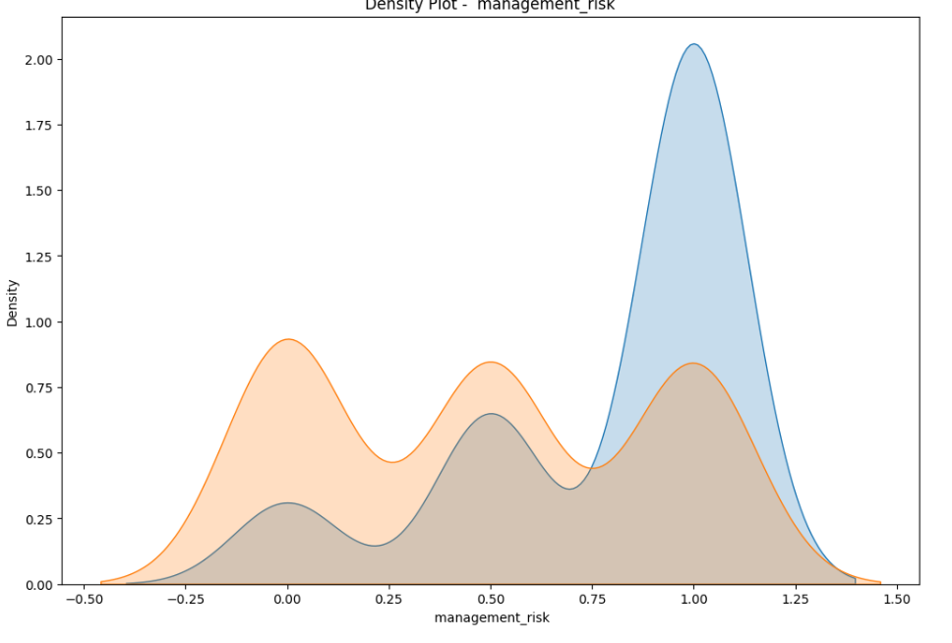
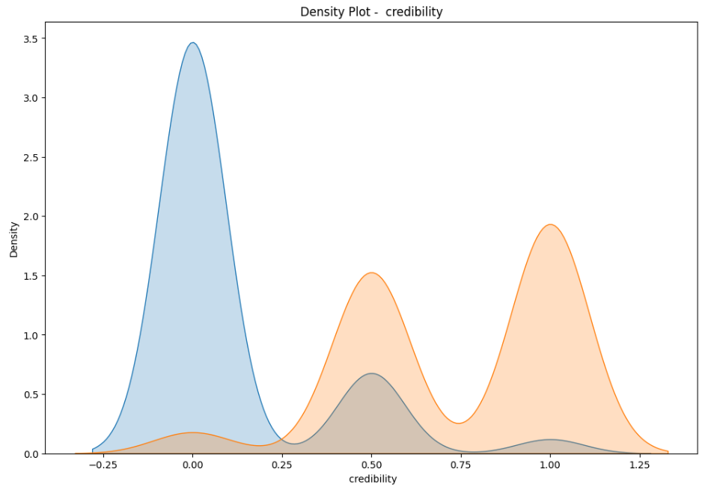
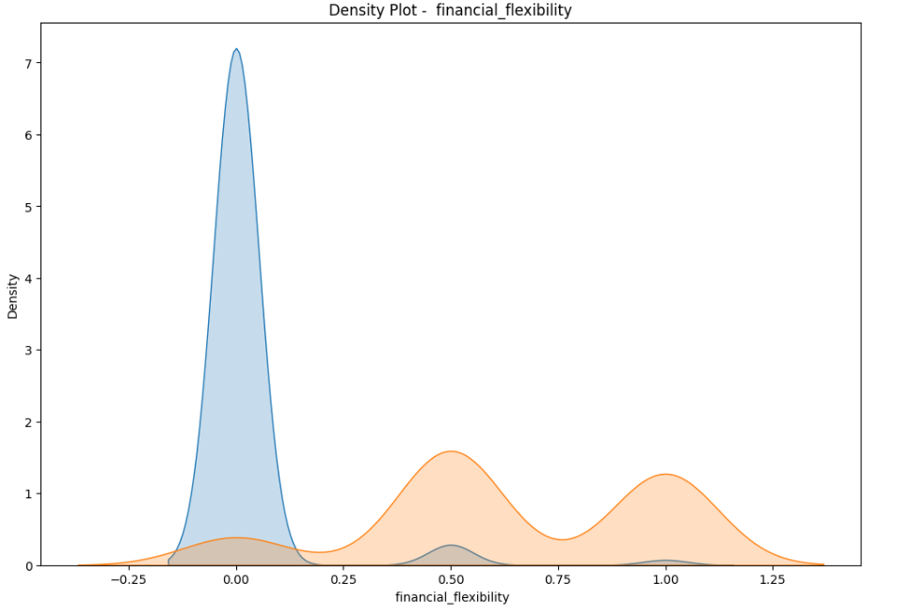
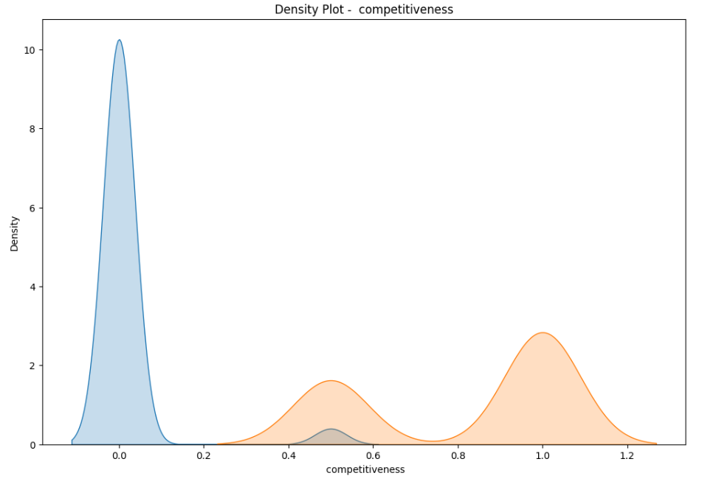
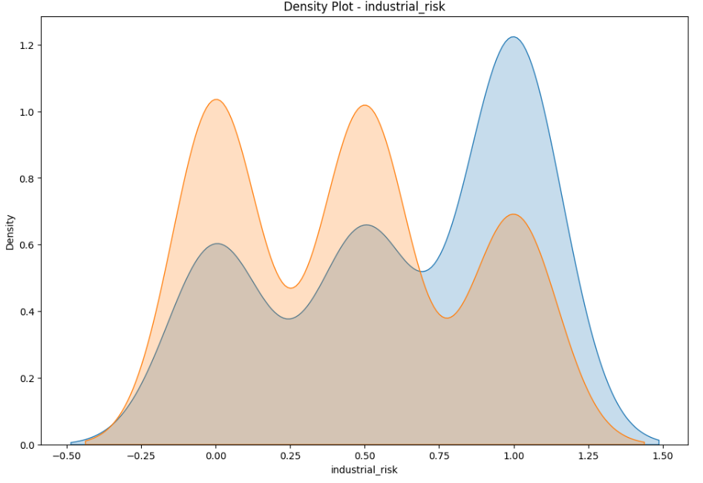
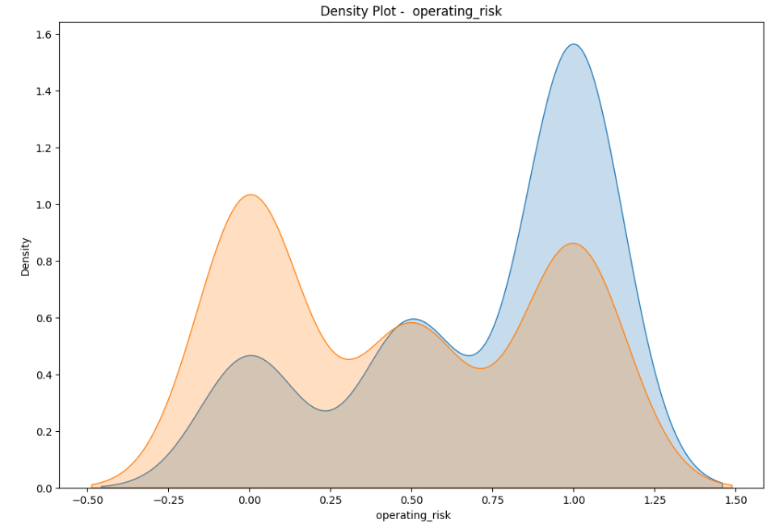
Visualization (Contd)
Density Plots
Management_risk
Credibility
Financial_flexibility
Competitiveness
Industrial_risk
Operating_risk

Slide 9
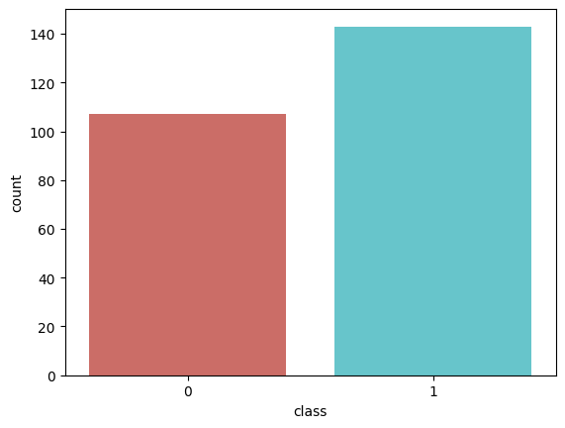
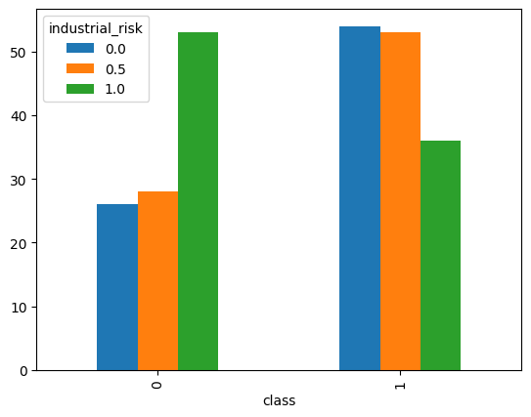
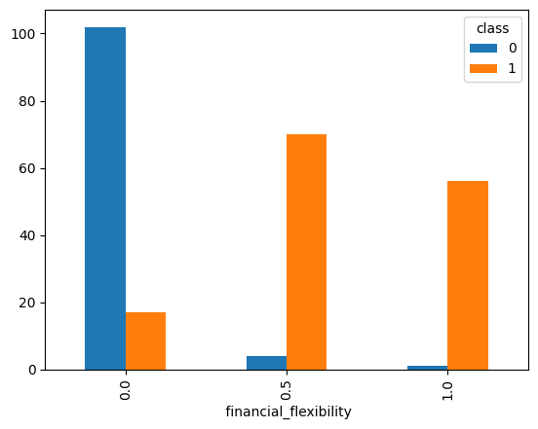
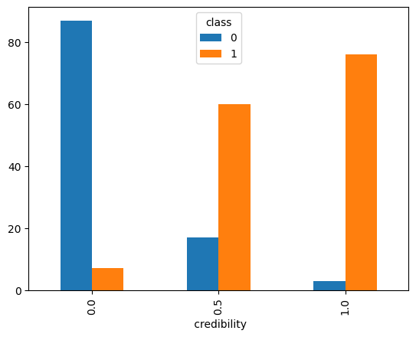
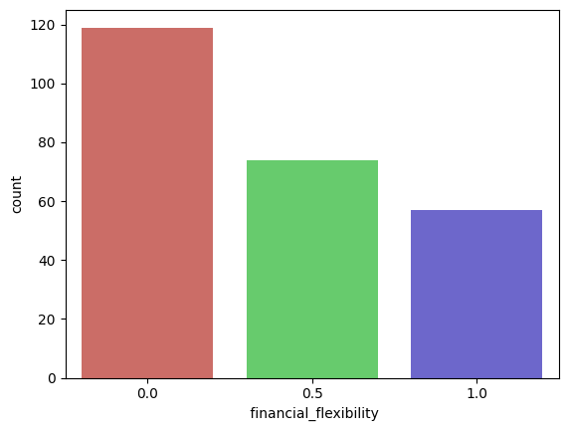
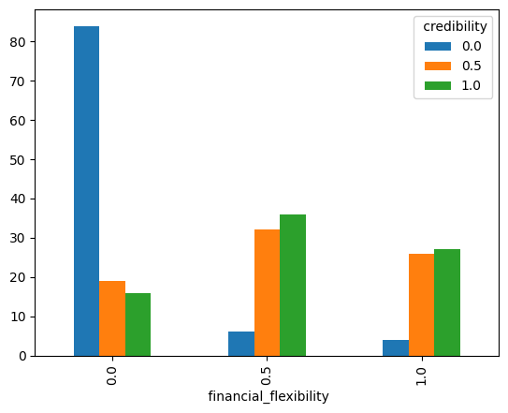
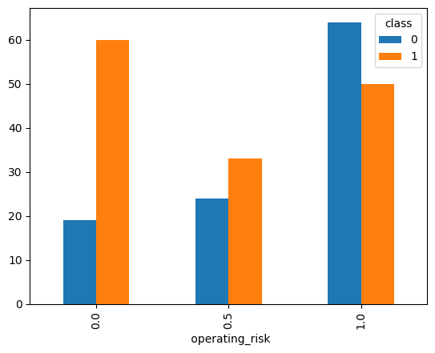
Visualization (Contd)
Count plot
Cross Tab plots

Slide 10
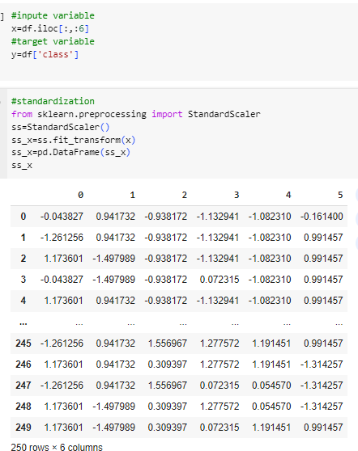
Transformation
StandardScalar:
removes the mean and scales each feature/variable to unit variance

Slide 11
Models Evaluated
Logistic Regression
Decision Tree
Naives' Bayes Classifier
Support Vector Machine
KNN
Random Forests
Ensemble Methods
Bagging
Gradient Boosting
Ada Boost
Extreme Gradient Boosting

Slide 12
Model Metrics
Decision Metrics
Precision
Recall
F1 Score
Accuracy(Training data & Testing data)
ROC-AUC Curve
Specificity

Slide 13
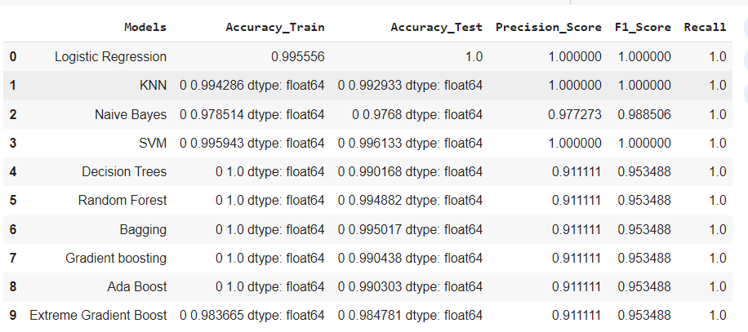
Models Results

Slide 14
Selection of Best Model
We have selected the model-LOGISTIC REGRESSION
WHY?
Simple, interpretable, and provides probabilities of class membership
It is very fast at classifying unknown records.
Logistic regression is less inclined to over-fitting but it can overfit in high dimensional datasets

Slide 15

Model Deployment

Slide 16
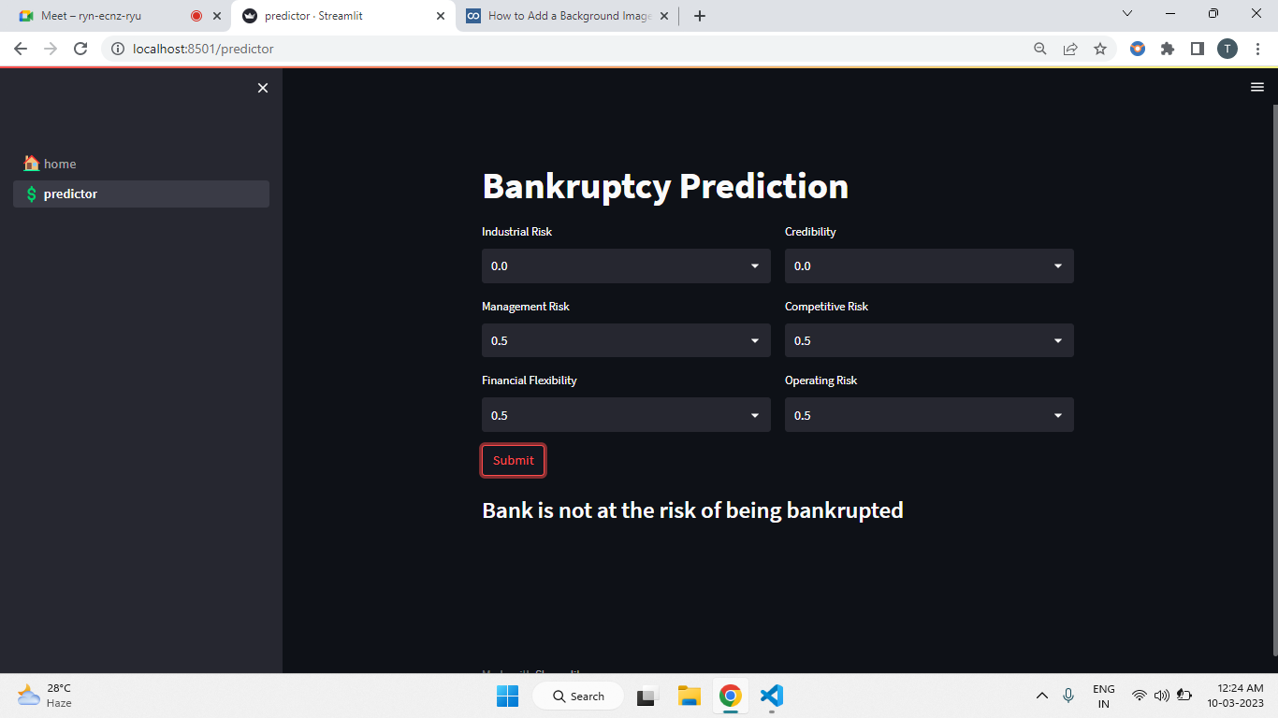

Results
Based on the input value selected, that the user has selected the model returns the status of the whether the organization goes bankrupt or not.

Slide 17
Challenges
The data research is most likely low sensitivity , for instance ,either good/bad or yes/no . Quantitative analysis cannot be performed on categorical data which means that numerical or arithmetic operations cannot be performed.

Slide 18


